Slide 1

Green Pace
Security Policy Presentation
Developer: Teodoir O’Ceallaigh

Slide 2

OVERVIEW: DEFENSE IN DEPTH
Defense in Depth is the practice of implementing a multitude of security layers - including redundancies and factors that are both physical and technical. This immense amount of security means that as defenses may be whittled away here and there, there is more likely to be an opportunity to catch and prevent the attack or breech prior to actually succumbing to the threat at full scale.

Slide 3
THREATS MATRIX
Likely Threats that have a high chance of happening. | Priority Priority to handle is high and should not be delayed.
Low priority Priority is low and if other concerns are present this can be delayed. | Unlikely Threats that have a low chance of happening.
With secure coding standards there is an array of measurements that can tell how vulnerable or immediate a threat qualifies as and in turn how they should be prioritized.

Slide 4
10 PRINCIPLES
Validate Input Data: SQL Injection & Exceptions.
Heed Compiler Warnings: Exceptions, String Correctness, & Memory Protection
Architect and Design for Security Policies: Object Oriented Programming & Memory Protection.
Keep It Simple: Object Oriented Programming, Exceptions, String Correctness, Daa Type * Data Value.
Default Deny: Data Value, Exceptions, & Assertions.
Adhere to the Principle of Least Privilege: SQL Injection, Memory Protection, & Data Value.
Sanitize Data Sent to Other Systems: Data Value & Memory Protection.
Practice Defense in Depth :Exceptions, Assertions, SQL Injection, Data Type, String Correctness, & Data Value.
Use Effective Quality Assurance Techniques: String Correctness & Memory Protection.
Adopt a Secure Coding Standard: Exceptions, Assertions, & Data Value.

Slide 5
CODING STANDARDS
Data Type: Do not write syntactically ambiguous declarations
Data Value: Avoid information leakage when passing a class object across a trust boundary
String Correctness: Use valid references, pointers, and iterators to reference elements of a basic_string
SQL Injection: Use valid format strings and input validation.
Memory Protection: Free dynamically allocated memory when no longer needed
Assertions: Use a static assertion to test the value of a constant expression
Exceptions: Handle all exceptions
Containers: Use valid iterator ranges
Object Oriented Programming: Write constructor member initializers in the canonical order
Exceptions: Handle all exceptions thrown before main() begins executing

Slide 6
ENCRYPTION POLICIES
Encryption In Flight:
…is the process of data encryption while being transmitted.
Encryption At Rest:
…is the implementation of data encryption while the data is at rest wherever it may be stored.
Encryption In Use:
…is the active encryption and decryption process during work to prevent the access of the data while it is being utilized through tools such as through cached memory.

Slide 7
TRIPLE-A POLICIES
Authentication:
…is the process of requiring a user to validate their credentials through one or more steps. Think password and usernames.
Authorization:
…is the process of granting permissions after access has been gained based on what the user reasonably needs access to. You may need to log into class but you don’t need authorization to edit your grades.
Accounting:
…is the process of system clean up through the monitoring and auditing of authentication and authorization of users and tools. If someone is misusing or not using something, then they don’t need access to it and their credentials and/or access can be removed.

Slide 8
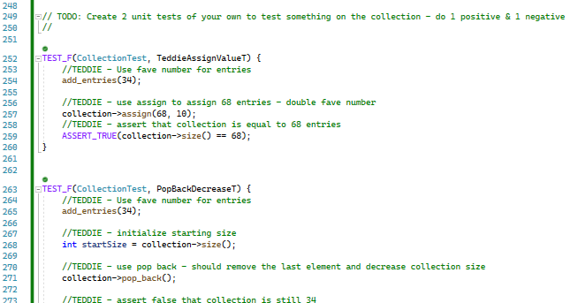
Assigning Value - Unit Test
In one test I wrote I wanted to validate the ability of the program to assign a value to the collection, which resulted in a positive test completion among the others that were outlined.

Slide 9
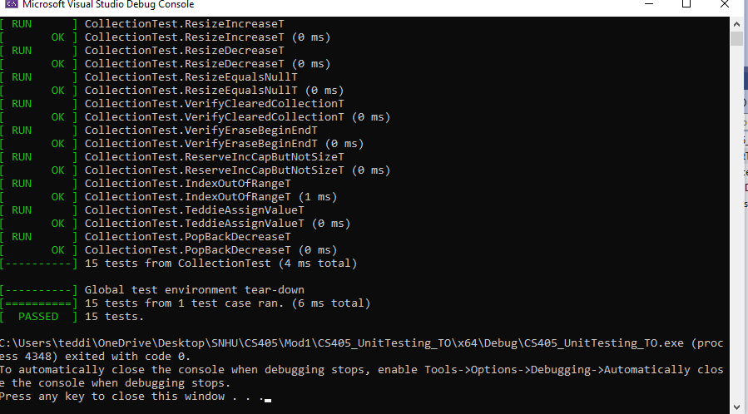
Decrease Size - Unit Testing
For my second during unit testing I wanted to est the negative response for utilizing a pop back and collection size reduction. This test ran successfully in form and function while remaining negative in terms of the expected process.

Slide 10

AUTOMATION SUMMARY

Slide 11
TOOLS
A strong DevSecOps Pipeline ensures that effective security practices are implemented and built into the full software development cycle - end-to-end! Previously in the DevOps Pipeline there was no pointed area to add in security but with DevSecOps we can action on multiple security points to create a better long term experience. In areas such as Build or Verify & Test we can see an additional area where during creation, compilation, and implementation there is a new structure to test.
While there are multiple security tools that can be utilized, the one that I would make a priority is the use of external auditing of the software/system to catch items that would not otherwise be caught. Other tools could include education of employees on security risks, code syntax checkers, dynamic and static testing, and many others.

Slide 12
RISKS AND BENEFITS
When it comes to coding here will always be a certain amount of risk that is being taken and would need to be addressed where possible. When vulnerabilities are discovered it is important to act on them as quickly as possible provided the update does not create a larger risk.
Where strategy comes in is during the planning and building process most wholly. While you can’t entirely erase risk you can do your best to create a secure program with forward thinking in terms of how it can be further armored in the future.
Ultimately, continuing to build an understanding and learn about risks and how to mitigate them will be the best plan long term in order to produce a more (but never fully) secure program.

Slide 13
RECOMMENDATIONS
My biggest recommendation is to take external auditing seriously and never fear a new iteration and the time and energy that come with that. Implementing DiD, even when it may feel never ending and overdone, has the potential to one day save your skin or the company that employs you from the reality that is black hackers with malicious motivations.

Slide 14
CONCLUSIONS
At the end of the day it is vital that we implement Defense in Depth with a strong focus on policy implementation and a zero-trust policy. Effective testing pre-launch will allow time to find and fix vulnerabilities and the redundant layers we employ - no matter how great we think we’ve done creating a secure software - will provide ample time to react when ultimately our defenses begin to be broken down by a bad egg.

Slide 15
REFERENCES
Sei cert C++ coding standard. SEI CERT C++ Coding Standard - SEI CERT C++ Coding Standard - Confluence. (n.d.). Retrieved June 15, 2022, from https://wiki.sei.cmu.edu/confluence/pages/viewpage.action?pageId=88046682
Agarwal, H. (2021, September 29). Why do hackers hack? [5 big reasons explained]. Appknox Mobile App Security Testing. Retrieved June 15, 2022, from https://www.appknox.com/blog/why-do-hackers-hack

